Slide 1
Planned Illiteracy
The Destruction of a Nation
By Oak Norton
www.UtahsRepublic.org

Slide 2
Background
2003—Daughter in 3rd grade
  No times tables, long division, division by fractions
  IE. no future in math
  Constructivist approach
“All the studies say this is the best way to teach math”
Notes:
I’m an accountant so I appreciate math.

Slide 3
Project Follow Through
Largest federal study ever performed
$1 Billion
180 Schools
79,000 Students
30 Years
Notes:
I started doing research and came across PFT.

Slide 4
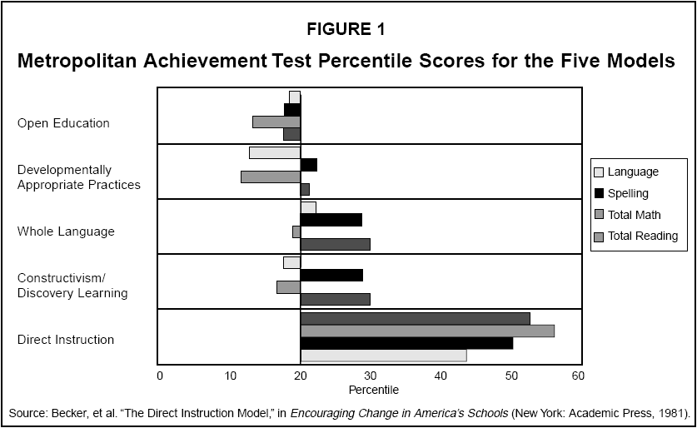
Project Follow Through Results

Slide 5
Project Follow Through Action Plan
Switch to Direct Instruction as the most effective method to teach children?
NO
Notes:
I started doing research and came across PFT.

Slide 6
Project Follow Through REAL Action
Put more money into failing methods like constructivism?
YES!
Notes:
I started doing research and came across PFT.

Slide 7
Why Dumb Down Math?
Math teaches
  Reasoning & Logic
  Foundation for geometry (thinking skills / “Proofs”)
  Algebra has been shown as the #1 success factor in college across all majors
A loss of math skills affects all thinking skills
Notes:
Educators have

Slide 8
45 Goals of the Communists
From Cleon Skousen's “The Naked Communist” (1961)
17. Get control of the schools. Use them as transmission belts for socialism and current Communist propaganda. Soften the curriculum. Get control of teachers' associations. Put the party line in textbooks.
18. Gain control of all student newspapers.
32. Support any socialist movement to give centralized control over any part of the culture-- education, social agencies, welfare programs, mental health clinics, etc.
36. Infiltrate and gain control of more unions. (NEA-Endorses Alinsky)
41. Emphasize the need to raise children away from the negative influence of parents. Attribute prejudices, mental blocks and retarding of children to suppressive influence of parents.

Slide 9
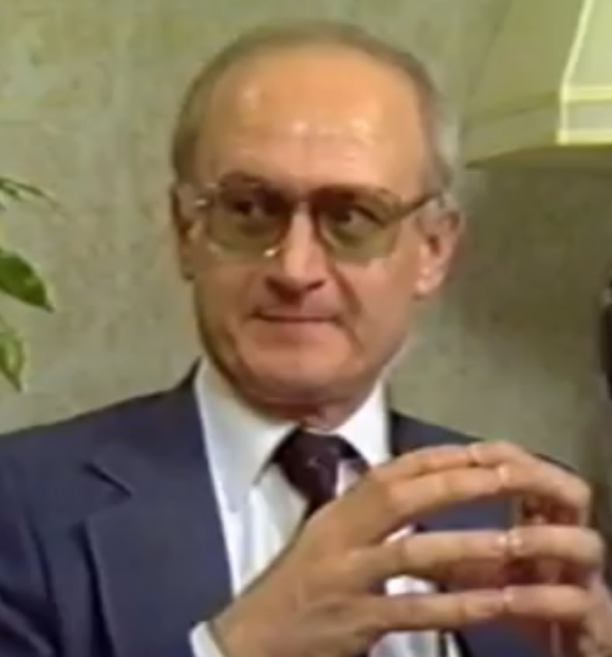
Yuri Bezmenov - KGB Defector
4 Steps to Communist Takeover of a Country
Demoralization - 15-20 years
  Process of making a country immoral so they cannot believe truth when it is presented to them
Destabilization - 2-5 years
  Create conditions where tipping points can occur
Crisis - 6 weeks
  Tipping points to seize power
Normalization
  Success – Government Control

Slide 10
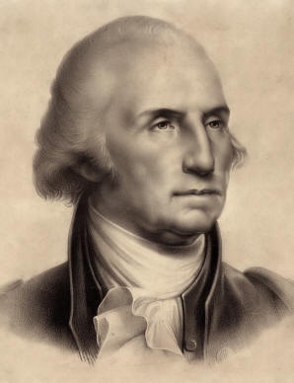
George Washington
Farewell Address
Of all the dispositions and habits which lead to political prosperity, religion and morality are indispensable supports. In vain would that man claim the tribute of patriotism, who should labor to subvert these great pillars of human happiness, these firmest props of the duties of men and citizens.

Slide 11
Contrast
Communism
  Goal: Enslave mankind
  Immoral people can’t recognize truth
  Remove the basis for morality by removing God by promoting atheism
  Make humanism the state religion
  People slide into bondage
United States Republic
  Goal: Free mankind
  Constitution based on natural law
  Only works when people respect the law
  Respect for the law comes through morality
  Moral teachings are learned though religion (10 commandments)
  Result: Righteous moral people enjoy freedom

Slide 12
Children are Insane?
"Every child in America entering school at the age of five is insane because he comes to school with certain allegiances to our founding fathers, toward our elected officials, toward his parents, toward a belief in a supernatural being, and toward the sovereignty of this nation as a separate entity. It’s up to you as teachers to make all these sick children well – by creating the international child of the future."
Dr. Chester M. Pierce, Harvard Professor of Education and Psychiatry, address to the Childhood International Education Seminar, 1973
Notes:
So where do our national education leaders fall into the spectrum?

Slide 13
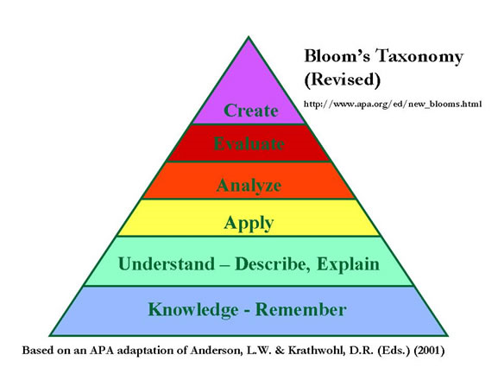
Benjamin Bloom’s Hierarchy of Learning
Remember this chart?
Notes:
We’ve probably all seen this hierarchy of learning by Benjamin Bloom where we learned about attaining “higher order thinking,” but do you know what his goal was in promoting higher order thinking?

Slide 14
Higher Order Thinking?
"…a student attains ‘higher order thinking’ when he no longer believes in right or wrong. A large part of what we call good teaching is a teacher´s ability to obtain affective objectives by challenging the student’s fixed beliefs. …a large part of what we call teaching is that the teacher should be able to use education to reorganize a child’s thoughts, attitudes, and feelings."
Benjamin Bloom, psychologist and educational theorist, in “Major Categories in the Taxonomy of Educational Objectives”, p. 185, 1956

Slide 15
Parents and Children
“Public education has served as a check on the power of parents, and this is another powerful reason for maintaining it.”
- John Goodlad, Developing Democratic Character in the Young, pg. 165
“Most youth still hold the same values of their parents… if we do not alter this pattern, if we don’t resocialize, our system will decay.”
– John Goodlad, Schooling for the Future, Issue #9, 1971
Notes:
There are more quotes I don’t have time to share such as John Goodlad specifically talking about the need to separate children from their parents so they don’t acquire their values.

Slide 16
UtahsRepublic.org
2009: Word “republic” is not in any K-12 history standards
Started UtahsRepublic.org as a petition to the state board to change 5 standards to recognize that we are a Constitutional Republic

Slide 17
Problems with Utah Standards (1/4)
6th grade
Objective: Determine human rights and responsibilities in the world.
a. Identify rights considered essential for all humans (e.g. health care, education, safety, freedom from fear, freedom of expression).
b. Propose steps individual students can take to protect these rights (e.g. support for sister schools, energy and resource conservation, letter writing, career choices, fundraising efforts).

Slide 18
Problems with Utah Standards (2/4)
8th grade
Objective: Examine the basic structure of the Constitution.
e. Determine the role of the Constitution as a living document.

Slide 19
Problems with Utah Standards (3/4)
8th grade
Objective: Determine the importance of popular sovereignty and limited government in a democratic society.
c. Determine how judicial review makes the Constitution a living document.

Slide 20
Problems with Utah Standards (4/4)
Utah Standard:
  Examine the impact of McCarthyism and Watergate on citizens’ attitudes toward government.
Texas Standard:
  Describe how Cold War tensions were intensified by the arms race, the space race, McCarthyism, and the House Un-American Activities Committee (HUAC), the findings of which were confirmed by the Venona Papers.
Notes:
Thanks to partisan school board races in Texas...

Slide 21


Planting Acorns (ideas)

Slide 22
Common Core Math Standards
Unproven
Huge cost to implement
Changes high school math from discrete courses to an integrated approach
  not many programs are ready for this approach but weak fuzzy math programs are
Tests written for Utah by a group led by a Social Justice education activist
Reject these standards

Slide 23
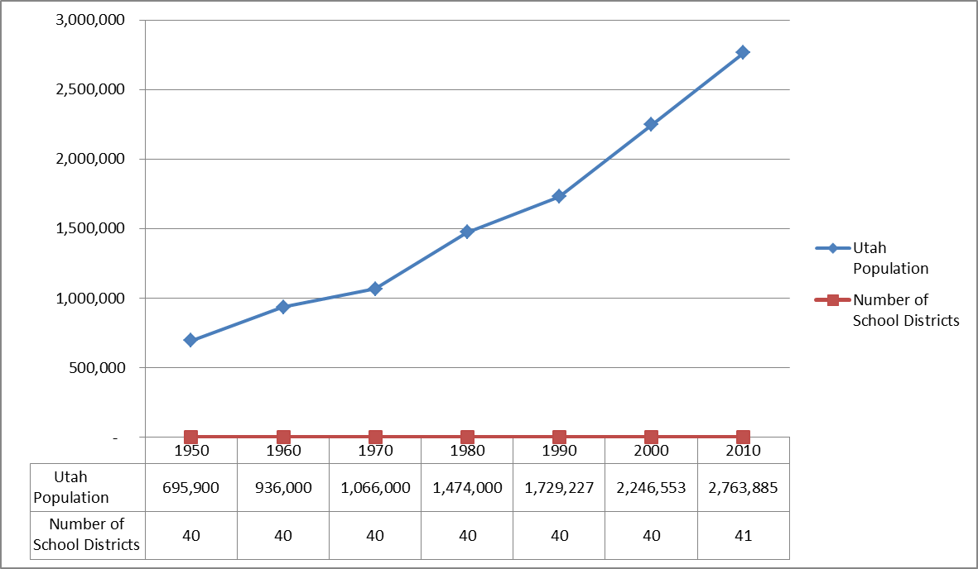
Utah Population & School Districts

Slide 24
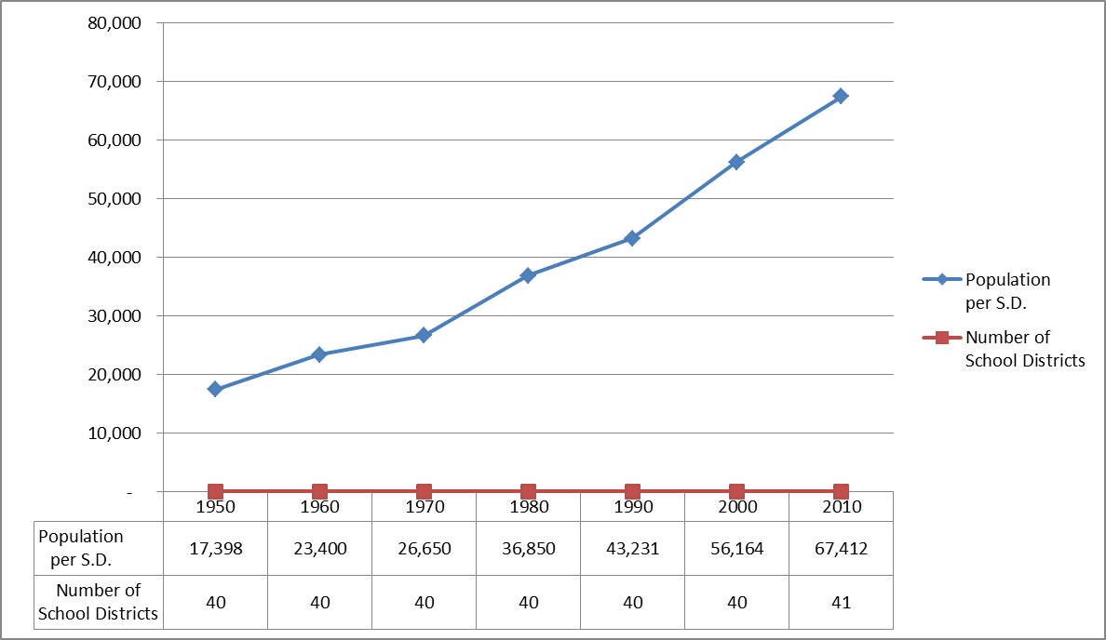
Utah Population Per School District
Notes:
Lets contrast this with what we might call a more inspired approach to growth

Slide 25
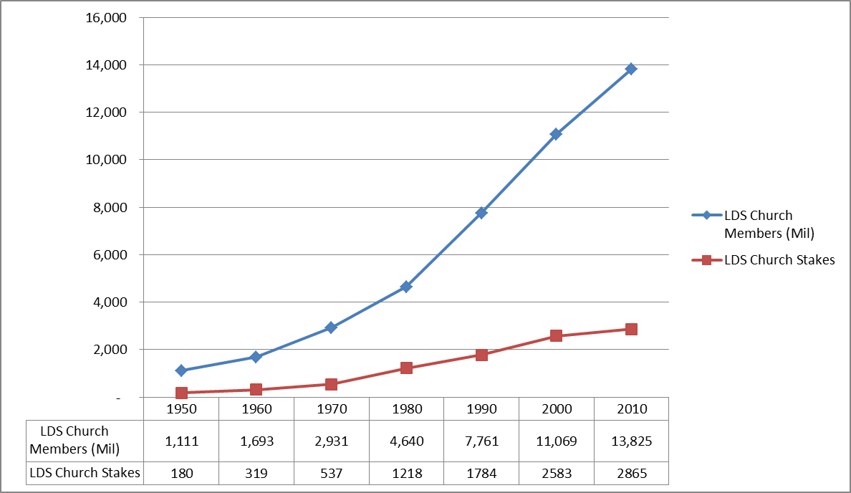
LDS Population & Stakes

Slide 26
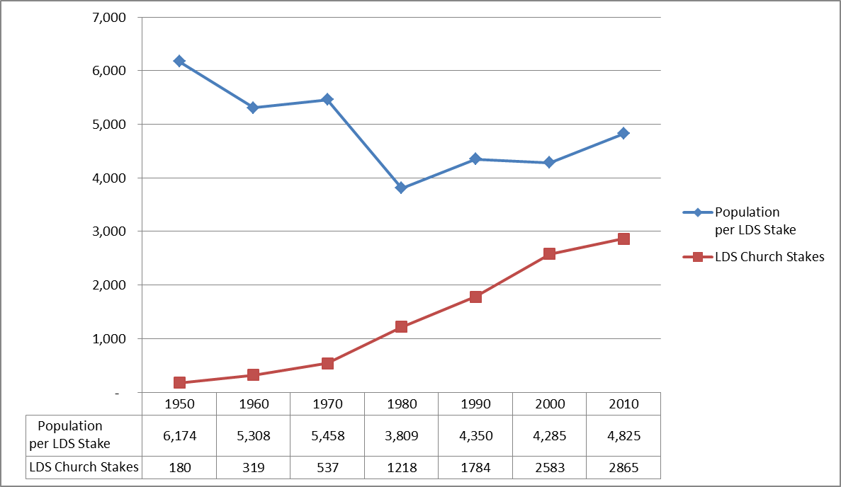
LDS Population Per Stake

Slide 27
What if High Schools were Districts?
 | Current System | What if Scenario
Utah School Districts | 40 | 116
Residents/District | 67,412 | 23,827
School Board Members | 205 | 580
Students/District | 13,228 | 4,561
LDS Members/Stake |  | 4,825
Current board members spend 15-20 hrs/week on district work (ASD)
Smaller districts = less work/member = more people willing to run
Less expensive to run for office-partisan school board races
Cut responsibilities to 5 hours/week & really empower School Community Councils
More board members means increased public interaction
Privatize maintenance and bussing and let schools focus on academics

Slide 28
Summary
Planned destruction of America
  Destroy morality
  Dumb down our children
  Humanism & Progressive Education
  Social re-engineering of our children

Slide 29
Solutions
Partisan school board elections
Shatter power grip over education by breaking up districts
Repeal Common Core standards adoption
Thorough review of state standards
Go to UtahsRepublic.org and sign the petition

